Slide 1

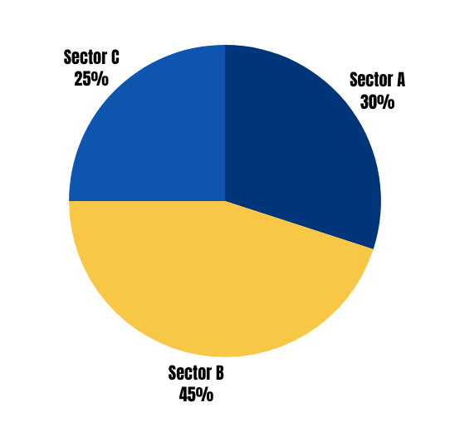
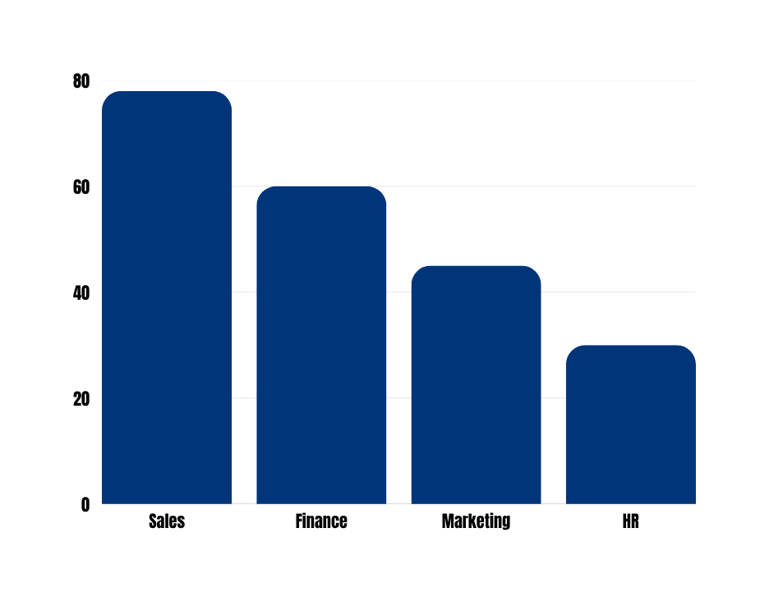

POSTER TITLE
  Title should be clear and in large fonts (e.g. Times New Roman > 80 points). Length: Keep the title concise (10-15 words maximum).
  Content: The title should clearly reflect the core of the research. It should be informative and specific.
  Font: Use large, bold font (e.g., 80-100 pt) to make the title easily readable from a distance.
  Placement: Center the title at the top of the poster
  Author Information: Beneath the title, include the full names of the authors, their affiliations, and any collaborating institutions.
  correspondding author
INTRODUCTION
METHODOLOGY
  Purpose: Briefly introduce the research topic, including background information and why the research is important.
  Key Elements:
  Context and significance of the study.
  The research question or hypothesis.
  Avoid going into too much detail—keep it brief but impactful.
  Length: Keep the introduction short (150-200 words).
  Font: Use a readable size (e.g., 40-50 pt) to ensure clarity.
  Purpose: Describe how the research was conducted. This section outlines the study design, participants, data collection methods, and analysis techniques.
  Study Design: Is it observational, experimental, qualitative
  Participants: Who was included in the study. (e.g., demographics, sample size).
  Data Collection: What tools or instruments were used. (e.g., surveys, interviews, medical tests).
  Data Analysis: How were the results analyzed. (e.g., statistical methods, software used).
  Length: Be concise (100-150 words). Use bullet points or short paragraphs for clarity.
General Formatting Tips
  Title: 80-100 pt.
  Section Headings: 40-50 pt.
  Body Text: 24-36 pt.
  Color Scheme: Use contrasting colors (e.g., dark text on a light background) to enhance readability.
  Spacing: Leave adequate space between sections to avoid clutter.
  Visual Elements: Use high-quality, labeled visuals like charts, graphs, and photos.
CONCLUSION
RESULT
  Purpose: Summarize the implications of your results. What do the findings mean in the broader context of the research area?
  Key Elements:
  Restate the key findings.
  Relate the findings to the research question or hypothesis.
  Mention any unexpected findings or limitations.
  Length: Keep this section short (75-100 words), summarizing the main takeaway.
  Purpose: Present the findings of the study. Use visual aids (graphs, tables, charts) to make the data easy to interpret.
  Key Elements:
  Highlight the main results or outcomes.
  Use visuals (e.g., bar graphs, pie charts) to present numerical data.
  Avoid overwhelming viewers with too much text—let the visuals do the talking.
  Include brief captions for each visual.
  Length: Focus on key results (100-150 words) with visual representations.
  Visual Design: Ensure that charts and graphs are clear, labeled, and easy to read.
RESOURCE ALLOCATION
PERFORMANCE INDICATORS
SECTOR A - 30%
SECTOR B - 45%
SECTOR C - 25%
RECOMMENDATIONS
  Purpose: Provide actionable suggestions based on your research findings. This section is often forward-looking and practical.
  Key Elements: What actions or future research should be taken?
  Recommendations could be for practice, policy, or further study.
  Length: Keep it brief but impactful (50-100 words).
ACKNOWLEDGEMENTS
  Purpose: Acknowledge any individuals, institutions, or organizations that contributed to your research.
  Key Elements:
  Thank your funding sources, advisors, research assistants, or any collaborators.
  Length: Keep this section very brief (1-3 sentences).
REFERENCES OR
ADDITIONAL RESOURCES

